Slide 1


Is delay always
harmful to precision?
Nikolett Német*, Scott Parkins
University of Auckland,
The Dodd-Walls Centre for Photonic and Quantum Technologies
Quantum Optics seminar 02/08/16
*n.nemet@auckland.ac.nz

Slide 2
Outline
Time-delayed Coherent feedback
Time-delay as a control parameter
Non-Markovian environment
Degenerate Parametric Amplifier (DPA)
Without feedback
With coherent feedback
DPA with time-delayed coherent feedback
Quantum mechanical model
Squeezing spectra
Classical analysis

Slide 3
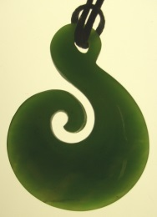
Quantum control
Open-loop control
Reaching the target state relies on the engineering of the desired Hamiltonian
No information is obtained about the state of the system
Coherent quantum feedback
No measurement
Coherent evolution of the output preserves the output quantum state
Closed-loop control
Information is obtained about the system’s state
Adjustment of the parameters accordingly
Measurement-based feedback
Coherent classical feedback
Measurement backaction

Slide 4
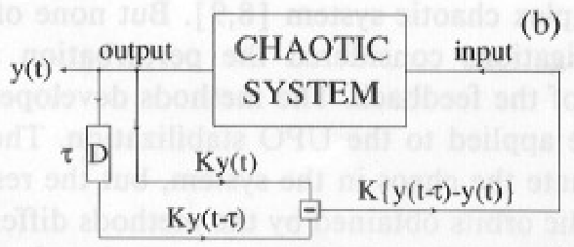
Time-delayed control
Classical example
Pyragas-type feedback
PLA 170:421 (1992), PRE 72:046203 (2005)
Extra degrees of freedom
Alters the relaxation time-scale
Stabilizes unstable periodic orbitals
Semiclassical
Stabilized laser dynamics (IEEE J.Q.El. 16:347 (1980), PRE 78:056213 (2008))
Quantum
Enhanced entanglement (PRA 91:052321 (2015))
Recovered Rabi oscillations in the single photon limit (PRL 110:013601 (2013), PRA 92:053801 (2015))
Faster convergence to a desired steady state (NJP 16:065004 (2014))

Slide 5
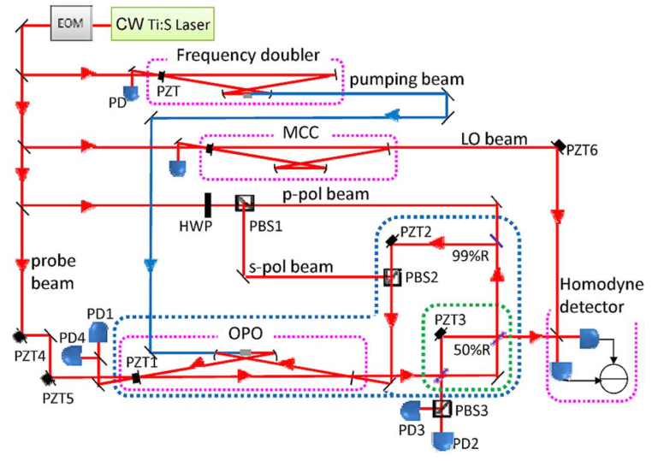
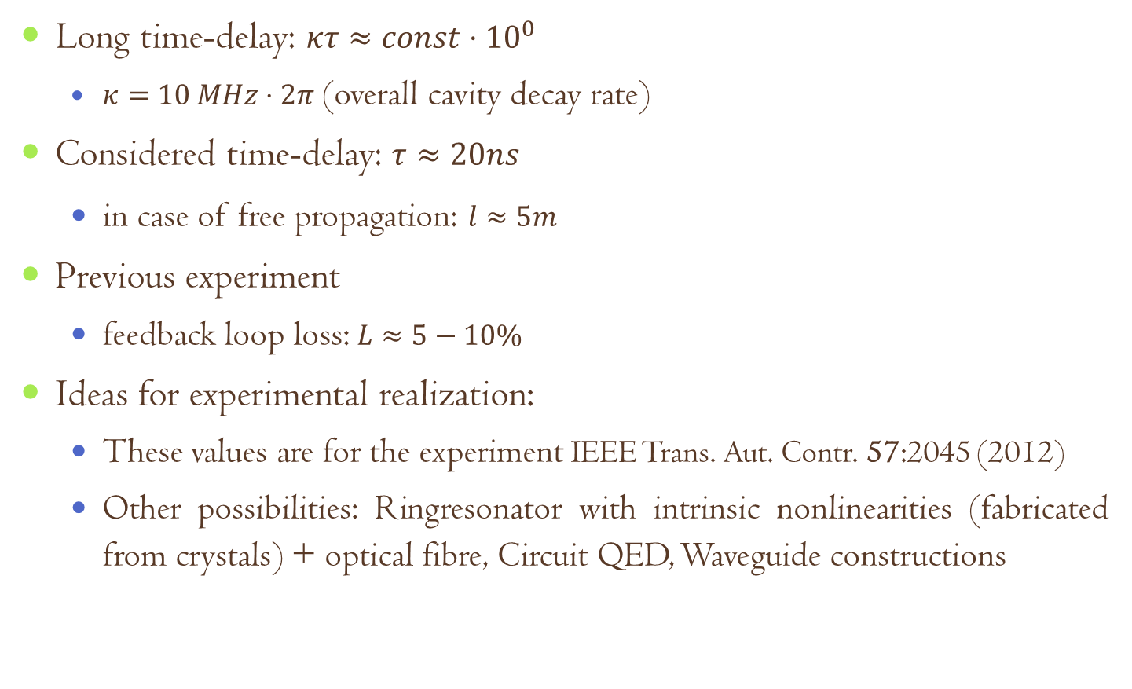
Feasibility of feedback with long time-delay
Long time-delay: $κτ≈const⋅{10}^{0}$
$κ=10 MHz⋅2π$ (overall cavity decay rate)
Considered time-delay: $τ≈20ns$
in case of free propagation: $l≈5m$
Previous experiment
feedback loop loss: $L≈5−10\%$
Ideas for experimental realization:
These values are for the experiment IEEE Trans. Aut. Contr. 57:2045 (2012)
Other possibilities: Ringresonator with intrinsic nonlinearities (fabricated from crystals) + optical fibre, Circuit QED, Waveguide constructions

Slide 6
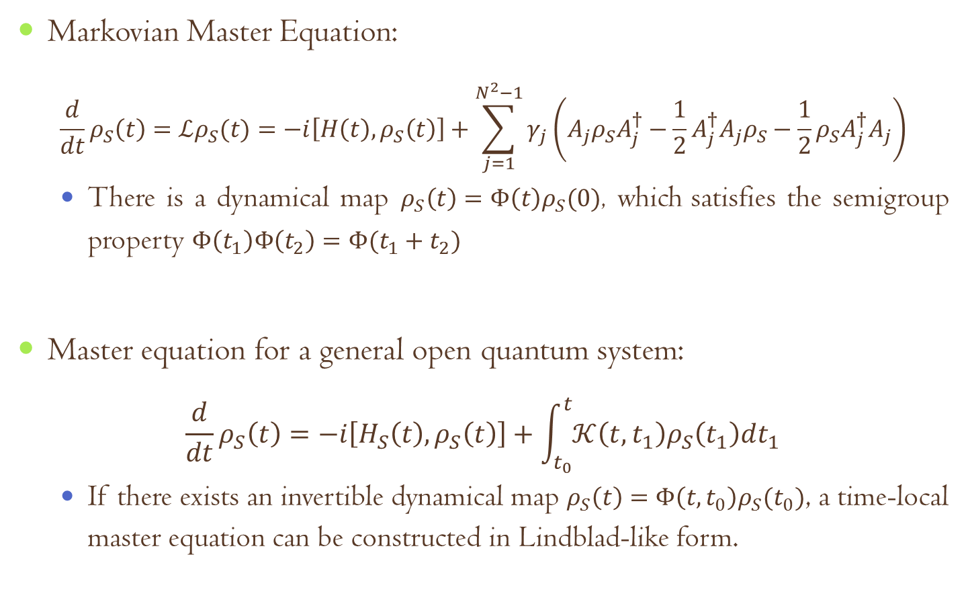
Open quantum system^{[1,2]}
Markovian Master Equation:
$$\frac{d}{dt}ρ_{S}\left(t\right)=ℒρ_{S}(t)=−i\left[H\left(t\right),ρ_{S}\left(t\right)\right]+\sum_{j=1}^{N^{2}−1}{γ_{j}\left(A_{j}ρ_{S}A_{j}^{†}−\frac{1}{2}A_{j}^{†}A_{j}ρ_{S}−\frac{1}{2}ρ_{S}A_{j}^{†}A_{j}\right)}$$
There is a dynamical map $ρ_{S}\left(t\right)=Φ\left(t\right)ρ_{S}(0)$, which satisfies the semigroup property $Φ\left(t_{1}\right)Φ\left(t_{2}\right)=Φ(t_{1}+t_{2})$
Master equation for a general open quantum system:
$$\frac{d}{dt}ρ_{S}\left(t\right)=−i\left[H_{S}\left(t\right),ρ_{S}\left(t\right)\right]+\int_{t_{0}}^{t}{𝒦\left(t,t_{1}\right)ρ_{S}\left(t_{1}\right)dt_{1}}$$
If there exists an invertible dynamical map $ρ_{S}\left(t\right)=Φ\left(t,t_{0}\right)ρ_{S}(t_{0})$, a time-local master equation can be constructed in Lindblad-like form.
^{[1]} S. Whalen, PhD thesis (2015), ^{[2]} H.-P. Breuer, F. Petruccione The theory of open quantum systems (2007),

Slide 7
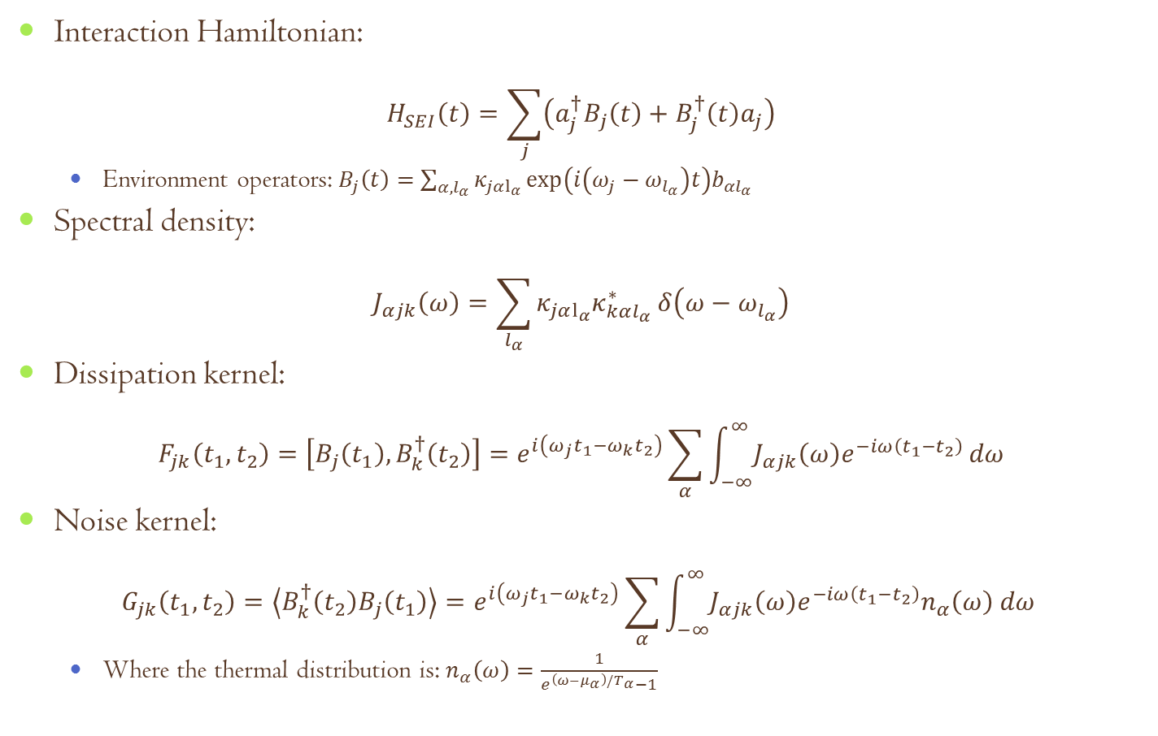
Description of the environment^{[1,2]}
Interaction Hamiltonian:
$$H_{SEI}\left(t\right)=\sum_{j}{\left(a_{j}^{†}B_{j}\left(t\right)+B_{j}^{†}\left(t\right)a_{j}\right)}$$
Environment operators:$B_{j}\left(t\right)=\sum_{α,l_{α}}{κ_{jαl_{α}}\exp\left(i\left(ω_{j}−ω_{l_{α}}\right)t\right)b_{αl_{α}}}$
Spectral density:
$$J_{αjk}\left(ω\right)=\sum_{l_{α}}{κ_{jαl_{α}}κ_{kαl_{α}}^{∗}δ\left(ω−ω_{l_{α}}\right)}$$
Dissipation kernel:
$$F_{jk}\left(t_{1},t_{2}\right)=\left[B_{j}\left(t_{1}\right),B_{k}^{†}\left(t_{2}\right)\right]=e^{i\left(ω_{j}t_{1}−ω_{k}t_{2}\right)}\sum_{α}{\int_{−∞}^{∞}{J_{αjk}\left(ω\right)e^{−iω\left(t_{1}−t_{2}\right)}}}dω$$
Noise kernel:
$$G_{jk}\left(t_{1},t_{2}\right)=\left\langle B_{k}^{†}\left(t_{2}\right)B_{j}\left(t_{1}\right)\right\rangle =e^{i\left(ω_{j}t_{1}−ω_{k}t_{2}\right)}\sum_{α}{\int_{−∞}^{∞}{J_{αjk}\left(ω\right)e^{−iω\left(t_{1}−t_{2}\right)}n_{α}\left(ω\right) dω }}$$
Where the thermal distribution is: $n_{α}\left(ω\right)=\frac{1}{e^{\left(ω−μ_{α}\right)/T_{α}}−1}$
^{[1]} S. Whalen, PhD thesis (2015), ^{[2]} S. Whalen, H. Carmichael PRA 93:063820 (2016)

Slide 8
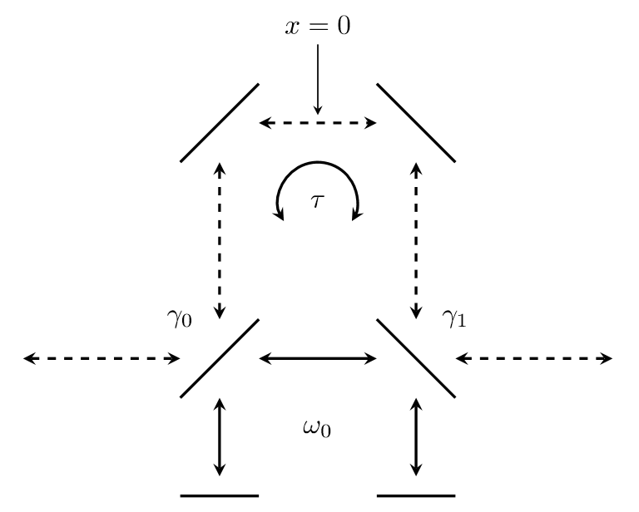
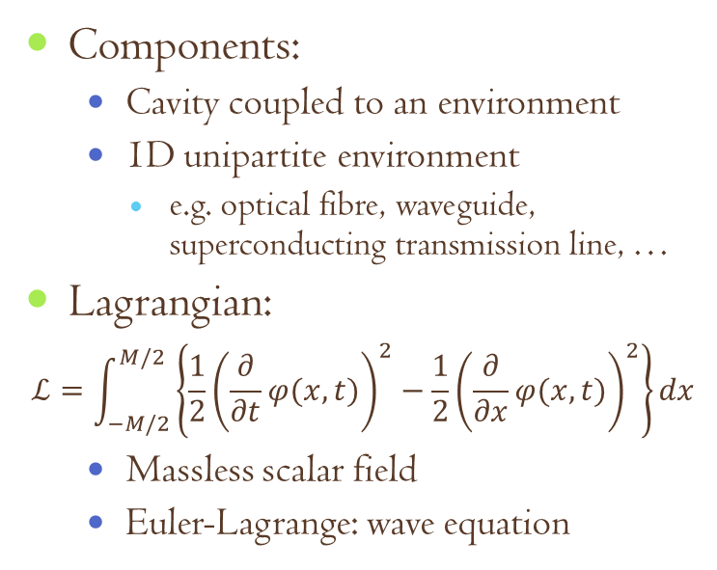
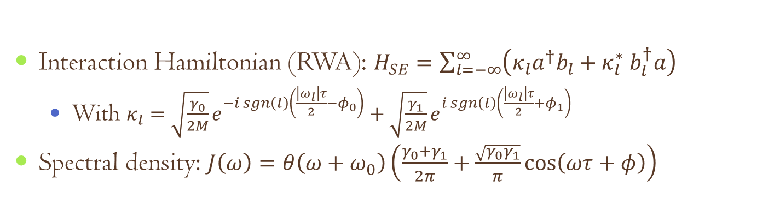
Time-delayed CQF model system^{[1]}
Components:
Cavity coupled to an environment
1D unipartite environment
e.g. optical fibre, waveguide, superconducting transmission line, …
Lagrangian:
$$ℒ=\int_{−M/2}^{M/2}{\left\{\frac{1}{2}{\left(\frac{∂}{∂t}φ(x,t)\right)}^{2}−\frac{1}{2}{\left(\frac{∂}{∂x}φ(x,t)\right)}^{2}\right\}}dx$$
Massless scalar field
Euler-Lagrange: wave equation
Interaction Hamiltonian (RWA): $H_{SE}=\sum_{l=−∞}^{∞}{\left(κ_{l}a^{†}b_{l}+κ_{l}^{∗}{ b}_{l}^{†}a\right)}$
With $κ_{l}=\sqrt{\frac{γ_{0}}{2M}}e^{−i sgn\left(l\right)\left(\frac{\left|ω_{l}\right|τ}{2}−φ_{0}\right)}+\sqrt{\frac{γ_{1}}{2M}}e^{i sgn\left(l\right)\left(\frac{\left|ω_{l}\right|τ}{2}+φ_{1}\right)}$
Spectral density: $J\left(ω\right)=θ\left(ω+ω_{0}\right)\left(\frac{γ_{0}+γ_{1}}{2π}+\frac{\sqrt{γ_{0}γ_{1}}}{π}\cos\left(ωτ+φ\right)\right)$
^{[1]} S. Whalen, PhD thesis (2015)

Slide 9
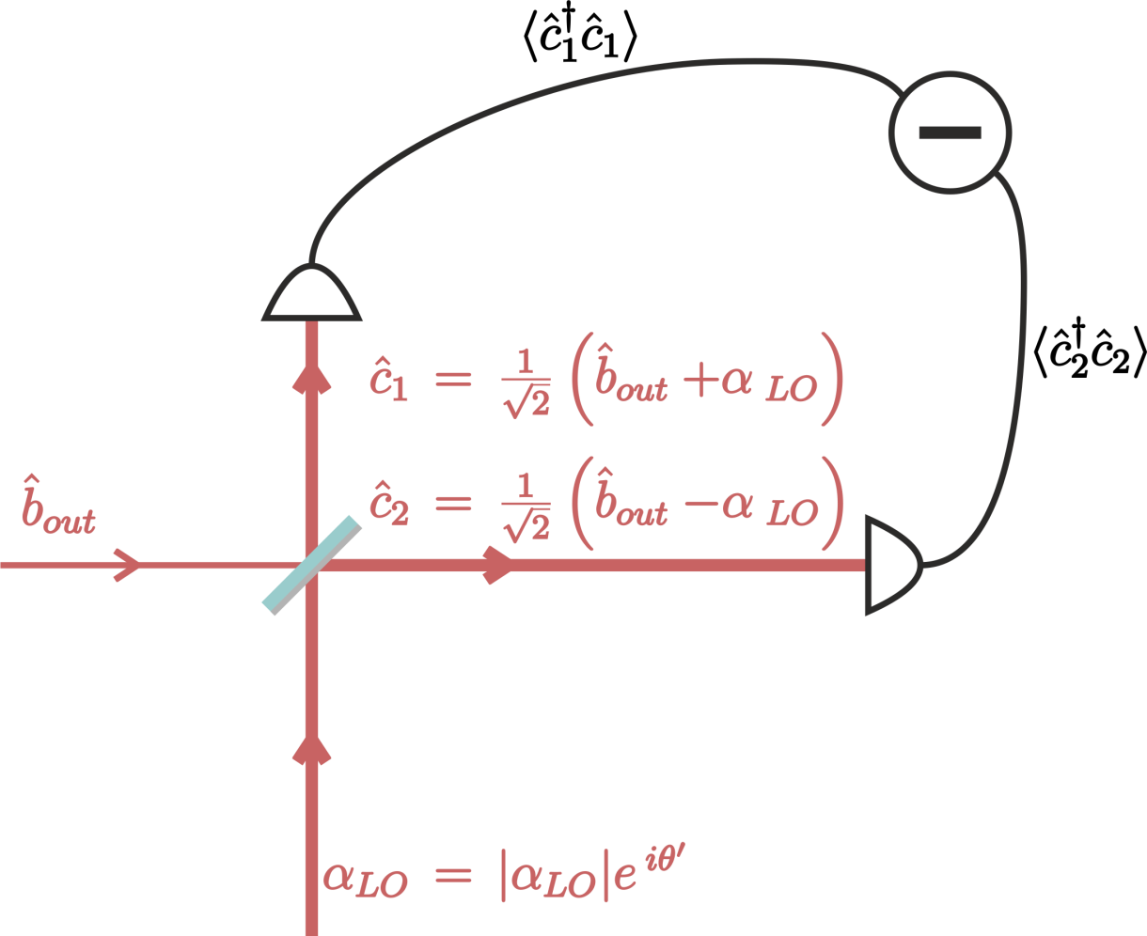
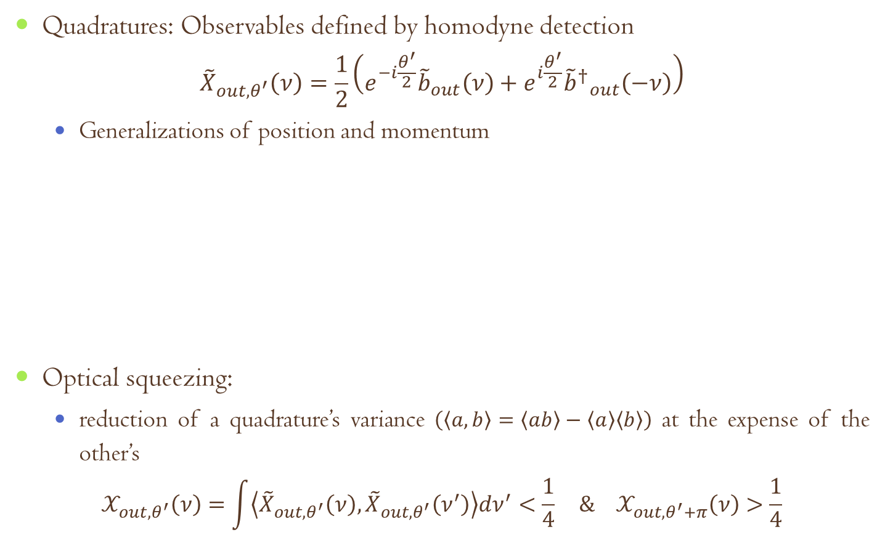
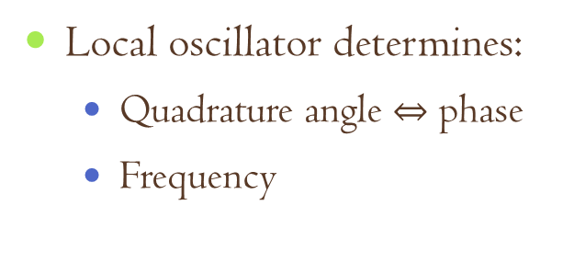
Optical squeezing
Quadratures: Observables defined by homodyne detection
$${\tilde{X}}_{out,θ^{′}}\left(ν\right)=\frac{1}{2}\left(e^{−i\frac{θ^{′}}{2}}{\tilde{b}}_{out}\left(ν\right)+e^{i\frac{θ^{′}}{2}}{{\tilde{b}}^{†}}_{out}^{}\left(−ν\right)\right)$$
Generalizations of position and momentum
Optical squeezing:
reduction of a quadrature’s variance $\left(\left\langle a,b\right\rangle =\left\langle ab\right\rangle −\left\langle a\right\rangle \left\langle b\right\rangle \right)$ at the expense of the other’s
$$𝒳_{out,θ^{′}}\left(ν\right)=\int{\left\langle {\tilde{X}}_{out,θ^{′}}\left(ν\right),{\tilde{X}}_{out,θ^{′}}\left(ν^{′}\right)\right\rangle dν^{′}<\frac{1}{4}} \& 𝒳_{out,θ^{′}+π}\left(ν\right)>\frac{1}{4}$$
Local oscillator determines:
Quadrature angle $⇔$ phase
Frequency

Slide 10
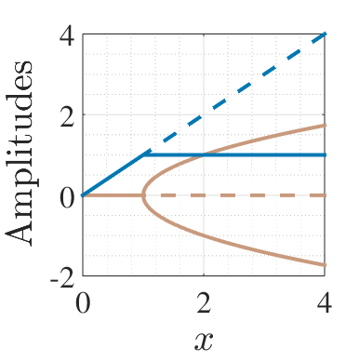
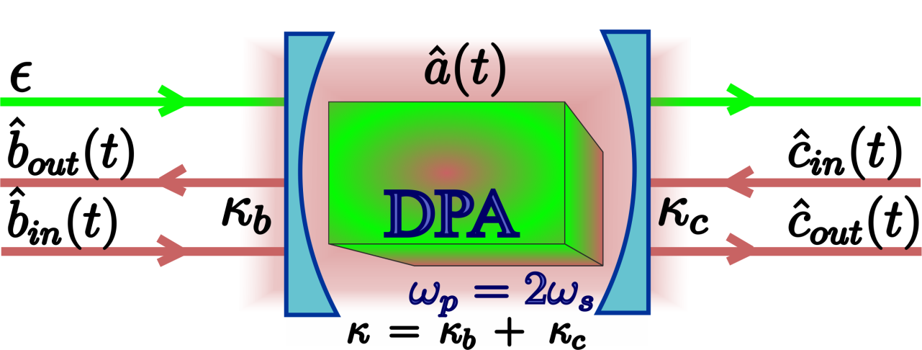
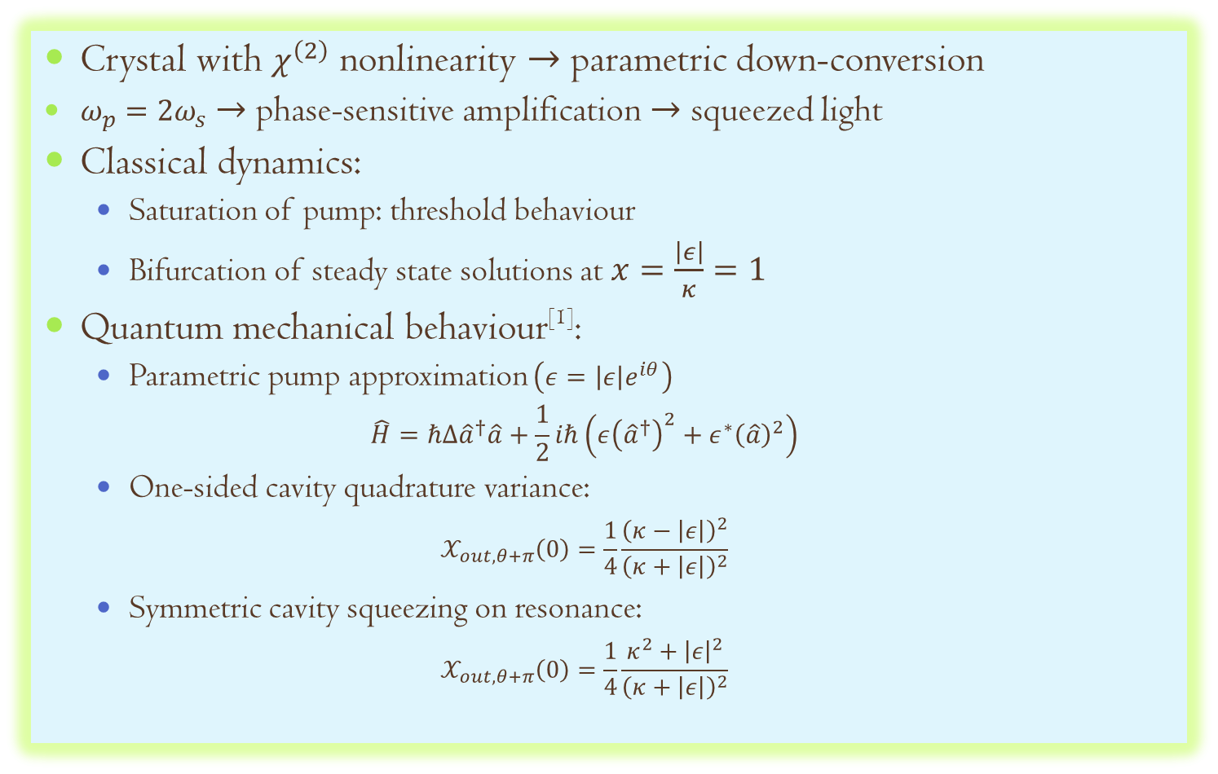
Degenerate Parametric Amplifier
Crystal with $χ^{\left(2\right)}$ nonlinearity $→$parametric down-conversion
$ω_{p}=2ω_{s}$ $→$ phase-sensitive amplification $→$ squeezed light
Classical dynamics:
Saturation of pump: threshold behaviour
Bifurcation of steady state solutions at $x=\frac{\left|ε\right|}{κ}=1$
Quantum mechanical behaviour^{[1]}:
Parametric pump approximation $\left(ε=\left|ε\right|e^{iθ}\right)$
$$\hat{H}=ℏΔ{\hat{a}}^{†}\hat{a}+\frac{1}{2}iℏ\left(ε{\left({\hat{a}}^{†}\right)}^{2}+ε^{∗}{\left(\hat{a}\right)}^{2}\right)$$
One-sided cavity quadrature variance:
$$𝒳_{out,θ+π}\left(0\right)=\frac{1}{4}\frac{{\left(κ−\left|ε\right|\right)}^{2}}{{\left(κ+\left|ε\right|\right)}^{2}}$$
Symmetric cavity squeezing on resonance:
$$𝒳_{out,θ+π}\left(0\right)=\frac{1}{4}\frac{κ^{2}+{\left|ε\right|}^{2}}{{\left(κ+\left|ε\right|\right)}^{2}}$$
^{[1]} M. Collett, C. Gardiner, PRA, 30:1386 (1984)

Slide 11
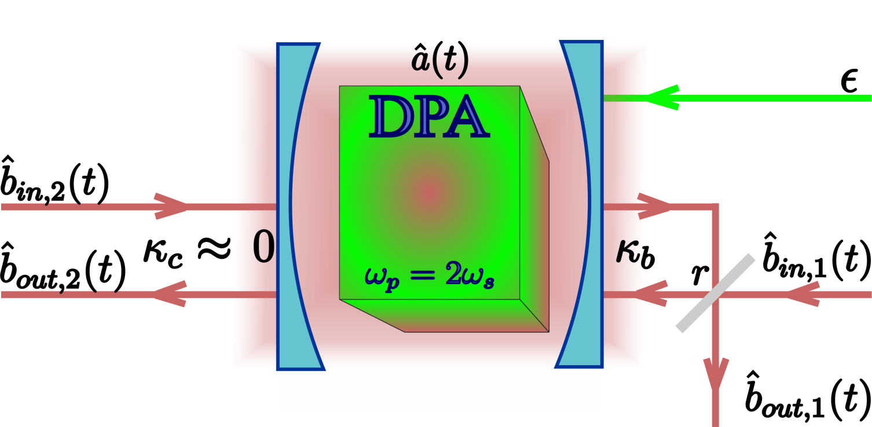
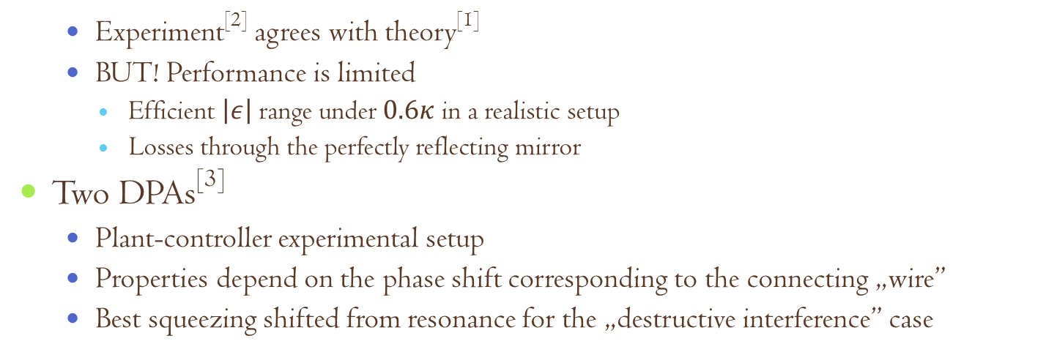
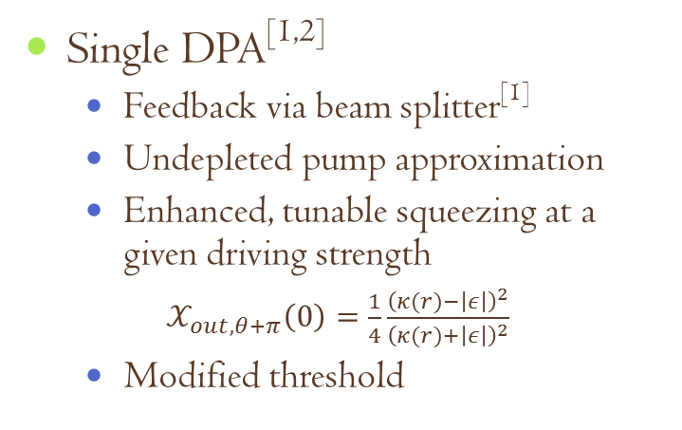
Coherent feedback with DPA^{[1,2]}
Single DPA^{[1,2]}
Feedback via beam splitter^{[1]}
Undepleted pump approximation
Enhanced, tunable squeezing at a given driving strength
$𝒳_{out,θ+π}\left(0\right)=\frac{1}{4}\frac{{\left(κ(r)−\left|ε\right|\right)}^{2}}{{\left(κ(r)+\left|ε\right|\right)}^{2}}$
Modified threshold
Experiment^{[2]} agrees with theory^{[1]}
BUT! Performance is limited
Efficient $\left|ε\right|$ range under $0.6κ$ in a realistic setup
Losses through the perfectly reflecting mirror
Two DPAs^{[3]}
Plant-controller experimental setup
Properties depend on the phase shift corresponding to the connecting „wire”
Best squeezing shifted from resonance for the „destructive interference” case
^{[1]} PRA, 80:042107 (2009), ^{[2]}IEEE Trans. Auto. Contr., 57:2045 (2012), ^{[3]}Opt. Exp., 21:18371 (2013)

Slide 12
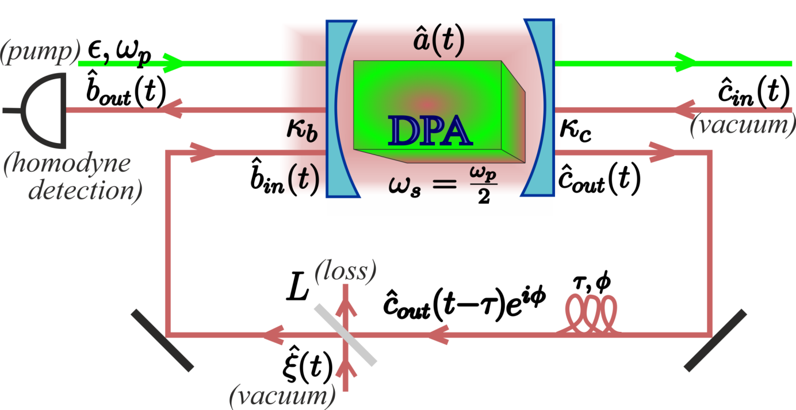
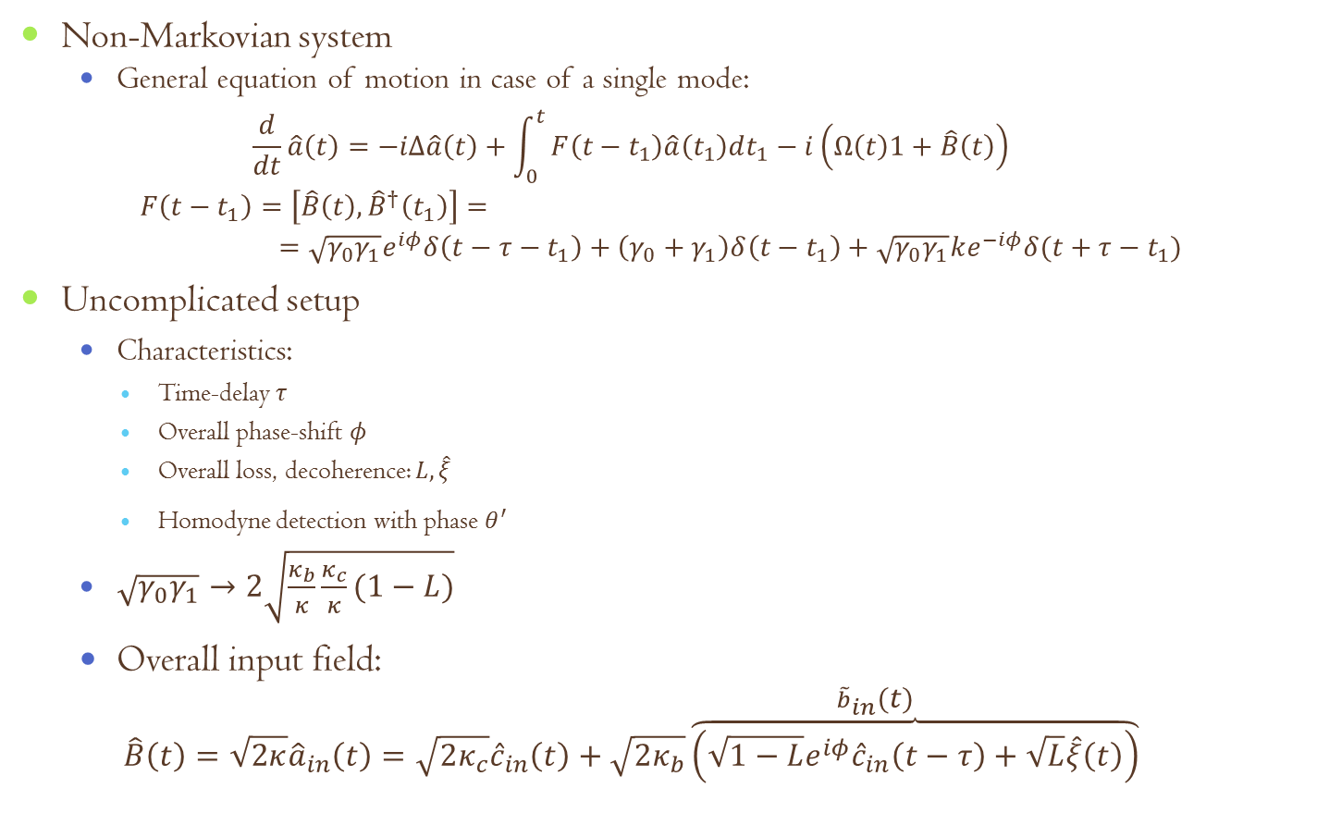
DPA with time-delayed coherent feedback
Non-Markovian system
General equation of motion in case of a single mode:
$$\frac{d}{dt}\hat{a}\left(t\right)=−iΔ\hat{a}\left(t\right)+\int_{0}^{t}{F\left(t−t_{1}\right)\hat{a}\left(t_{1}\right)dt_{1}−i\left(Ω\left(t\right)1+\hat{B}\left(t\right)\right)}$$
$$F\left(t−t_{1}\right)=\left[\hat{B}\left(t\right),{\hat{B}}^{†}\left(t_{1}\right)\right]==\sqrt{γ_{0}γ_{1}}e^{iφ}δ\left(t−τ−t_{1}\right)+\left(γ_{0}+γ_{1}\right)δ\left(t−t_{1}\right)+\sqrt{γ_{0}γ_{1}}ke^{−iφ}δ(t+τ−t_{1})$$
Uncomplicated setup
Characteristics:
Time-delay $τ$
Overall phase-shift $φ$
Overall loss, decoherence: $L,\hat{ξ}$
Homodyne detection with phase $θ^{′}$
$\sqrt{γ_{0}γ_{1}}→2\sqrt{\frac{κ_{b}}{κ}\frac{κ_{c}}{κ}(1−L)}$
Overall input field:
$$\hat{B}\left(t\right)=\sqrt{2κ}{\hat{a}}_{in}\left(t\right)=\sqrt{2κ_{c}}{\hat{c}}_{in}\left(t\right)+\overset{{\tilde{b}}_{in}\left(t\right)}{\sqrt{2κ_{b}}\overbrace{\left(\sqrt{1−L}e^{iφ}{\hat{c}}_{in}\left(t−τ\right)+\sqrt{L}\hat{ξ}\left(t\right)\right)}}$$
^{[1]} N. N., S. Parkins, PRA, 94:023809 (2016)

Slide 13
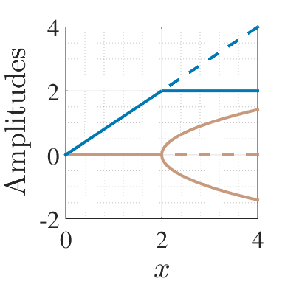
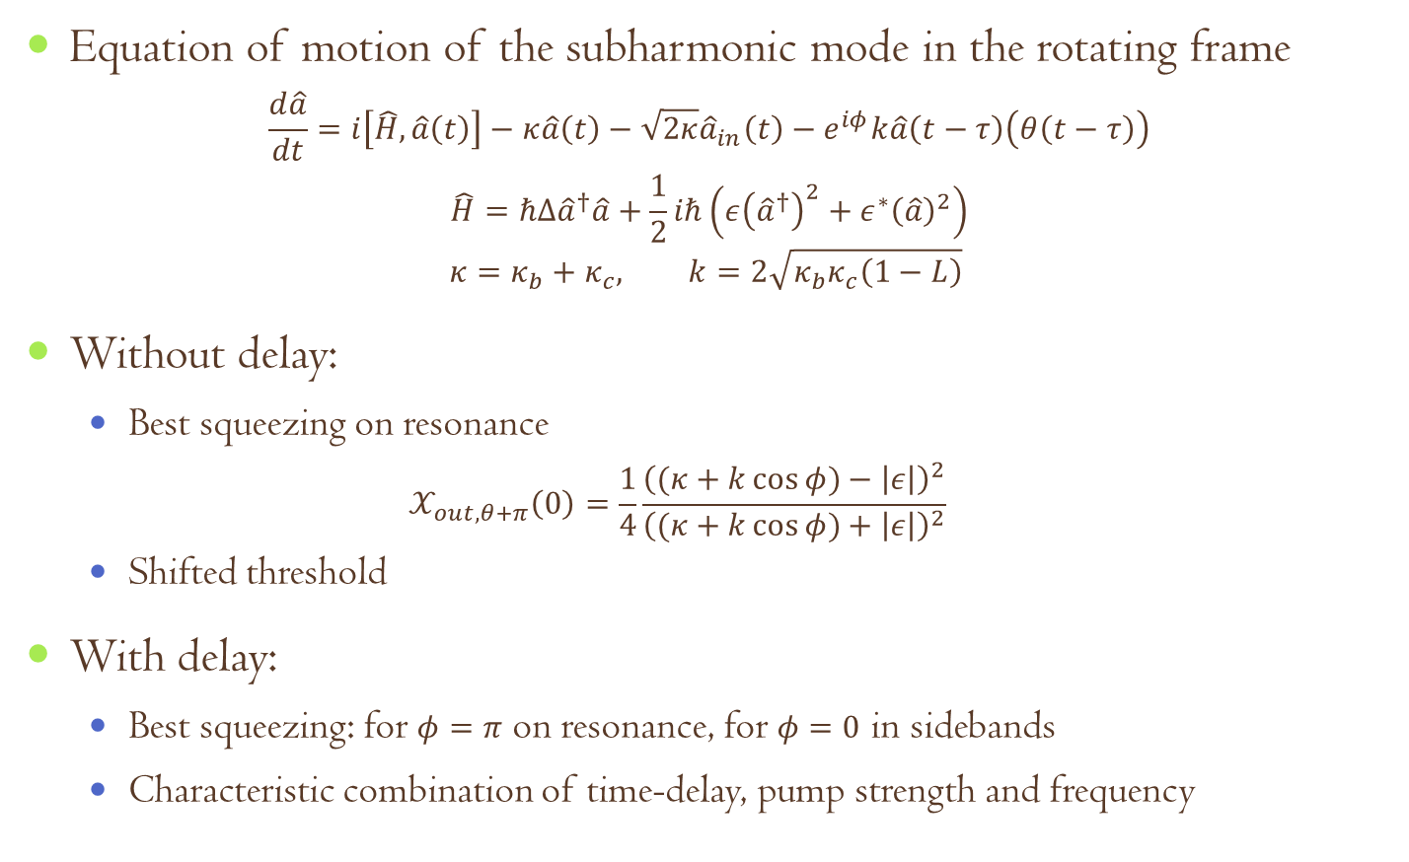
DPA with time-delayed coherent feedback
Equation of motion of the subharmonic mode in the rotating frame
$$\frac{d\hat{a}}{dt}=i\left[\hat{H},\hat{a}\left(t\right)\right]−κ\hat{a}\left(t\right)−\sqrt{2κ}{\hat{a}}_{in}\left(t\right)−e^{iφ}k\hat{a}\left(t−τ\right)\left(θ\left(t−τ\right)\right)$$
$$\hat{H}=ℏΔ{\hat{a}}^{†}\hat{a}+\frac{1}{2}iℏ\left(ε{\left({\hat{a}}^{†}\right)}^{2}+ε^{∗}{\left(\hat{a}\right)}^{2}\right)$$
$$κ=κ_{b}+κ_{c}, k=2\sqrt{κ_{b}κ_{c}\left(1−L\right)}$$
Without delay:
Best squeezing on resonance
$$𝒳_{out,θ+π}\left(0\right)=\frac{1}{4}\frac{{\left((κ+k\cos{φ})−\left|ε\right|\right)}^{2}}{{\left((κ+k\cos{φ})+\left|ε\right|\right)}^{2}}$$
Shifted threshold
With delay:
Best squeezing: for $φ=π$ on resonance, for $φ=0$ in sidebands
Characteristic combination of time-delay, pump strength and frequency
^{[1]} N. N., S. Parkins, PRA, 94:023809 (2016)

Slide 14
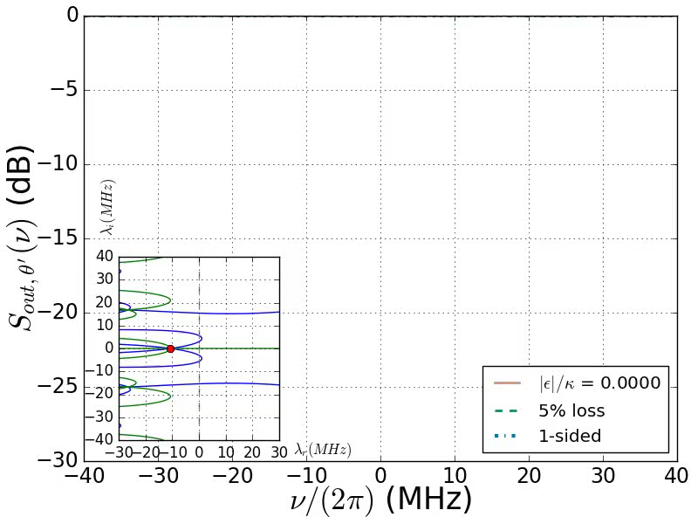

Squeezing spectra for $φ=π$

Slide 15
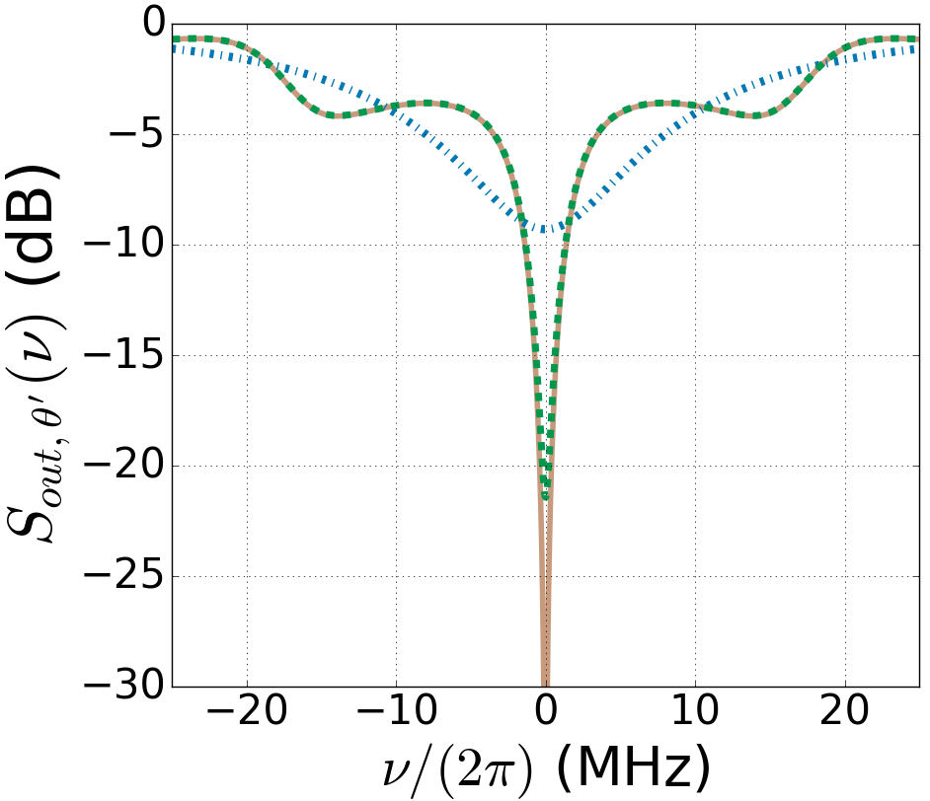
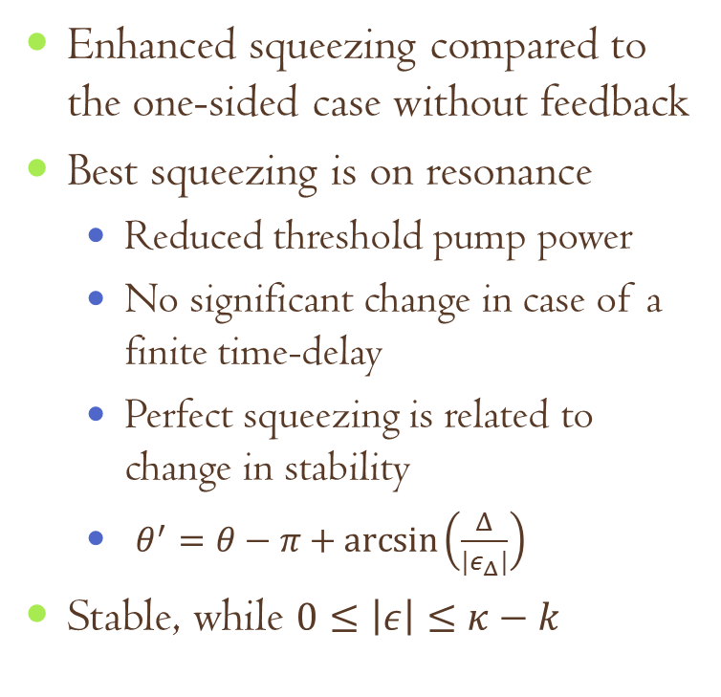
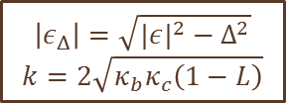

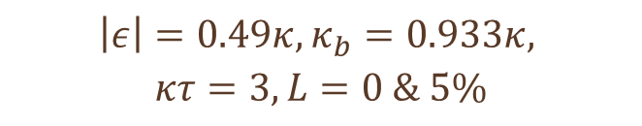
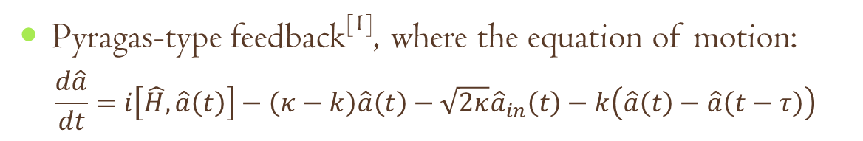
Squeezing for $φ=π$
Enhanced squeezing compared to the one-sided case without feedback
Best squeezing is on resonance
Reduced threshold pump power
No significant change in case of a finite time-delay
Perfect squeezing is related to change in stability
$θ^{′}=θ−π+\arcsin\left(\frac{Δ}{{|ε}_{Δ}|}\right)$
Stable, while $0≤\left|ε\right|≤κ−k$
$$\left|ε\right|=0.49κ, κ_{b}=0.933κ,$$
$$κτ=3,L=0 \& 5\%$$
Pyragas-type feedback^{[1]}, where the equation of motion:
$$\frac{d\hat{a}}{dt}=i\left[\hat{H},\hat{a}\left(t\right)\right]−\left(κ−k\right)\hat{a}\left(t\right)−\sqrt{2κ}{\hat{a}}_{in}\left(t\right)−k\left(\hat{a}\left(t\right)−\hat{a}\left(t−τ\right)\right)$$
$$\left|ε_{Δ}\right|=\sqrt{|{ε|}^{2}−Δ^{2}}$$
$$k=2\sqrt{κ_{b}κ_{c}\left(1−L\right)}$$
^{[1]} K. Pyragas, PLA, 170:421 (1992)

Slide 16
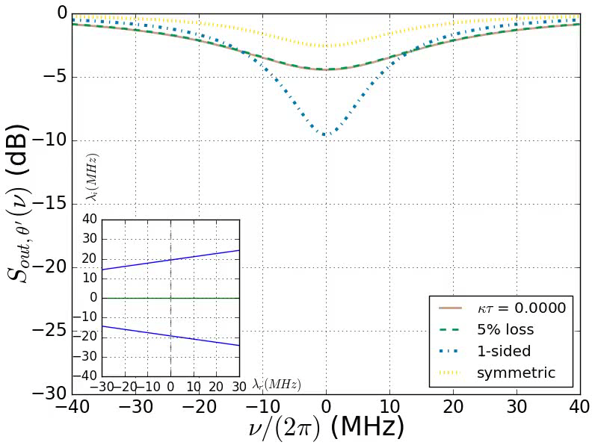

Squeezing spectra for $φ=0$

Slide 17
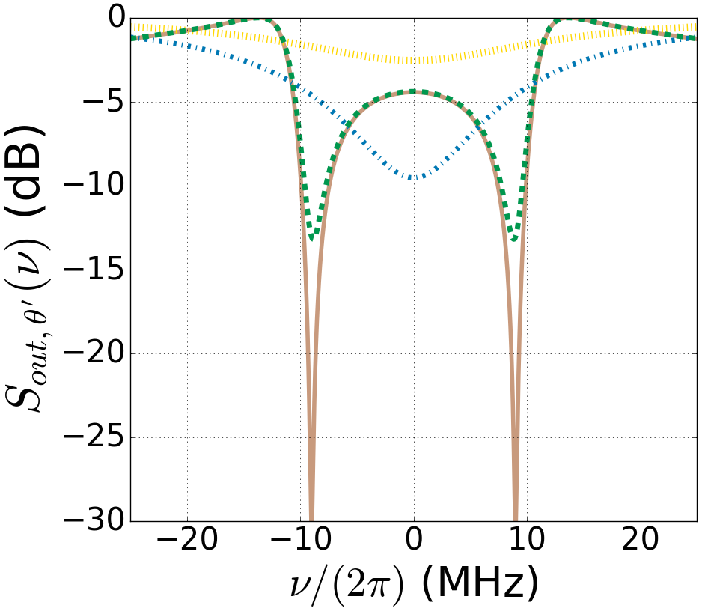
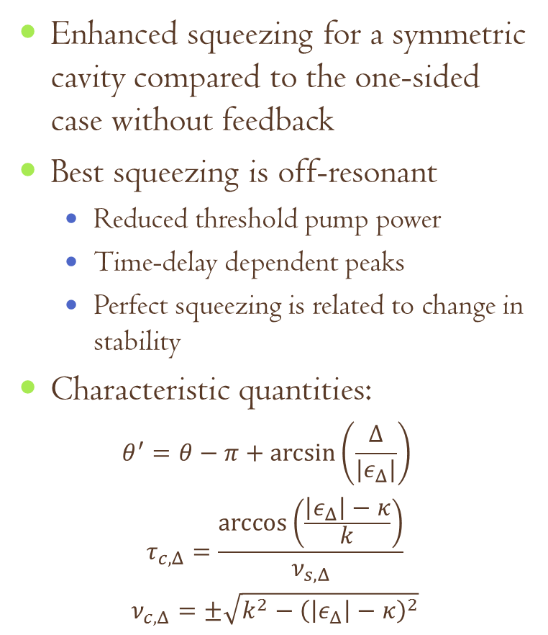

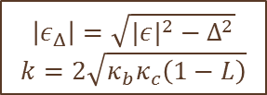
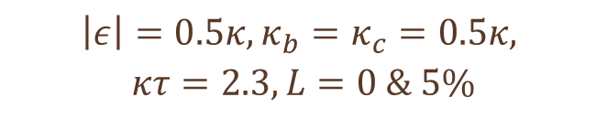
Squeezing for $φ=0$
Enhanced squeezing for a symmetric cavity compared to the one-sided case without feedback
Best squeezing is off-resonant
Reduced threshold pump power
Time-delay dependent peaks
Perfect squeezing is related to change in stability
Characteristic quantities:
$$θ^{′}=θ−π+\arcsin\left(\frac{Δ}{{|ε}_{Δ}|}\right)$$
$$τ_{c,Δ}=\frac{\arccos\left(\frac{\left|ε_{Δ}\right|−κ}{k}\right)}{ν_{s,Δ}}$$
$$ν_{c,Δ}=±\sqrt{k^{2}−{\left(\left|ε_{Δ}\right|−κ\right)}^{2}}$$
$$\left|ε\right|=0.5κ, κ_{b}=κ_{c}=0.5κ,$$
$$κτ=2.3,L=0 \& 5\%$$
$$\left|ε_{Δ}\right|=\sqrt{|{ε|}^{2}−Δ^{2}}$$
$$k=2\sqrt{κ_{b}κ_{c}\left(1−L\right)}$$

Slide 18
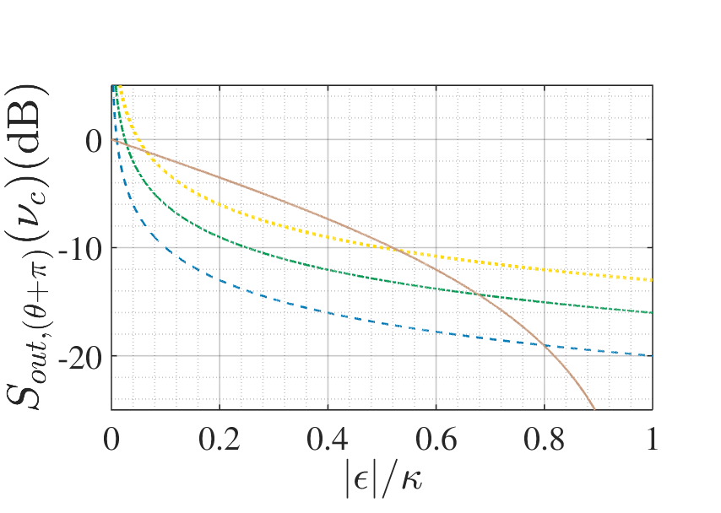
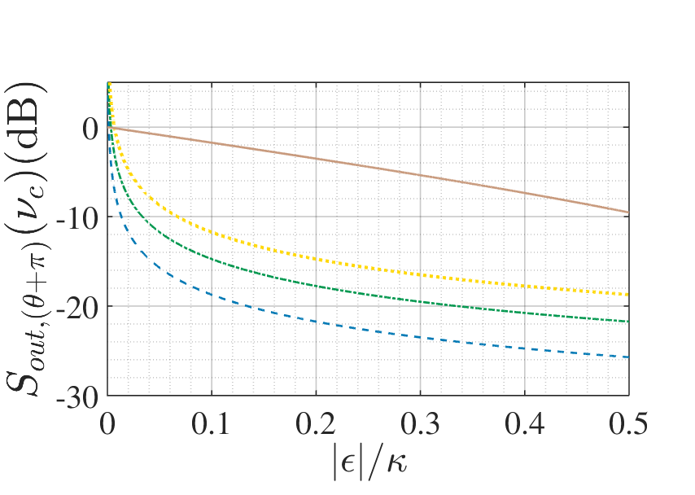
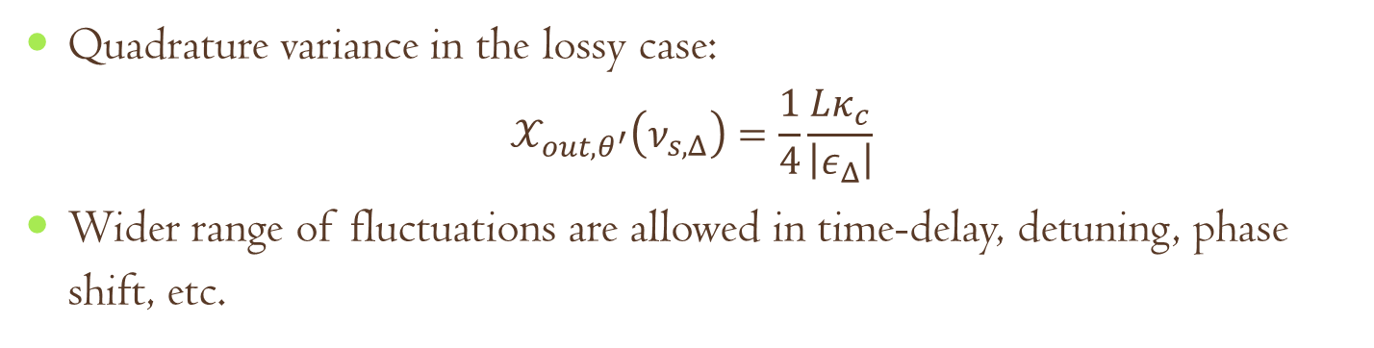
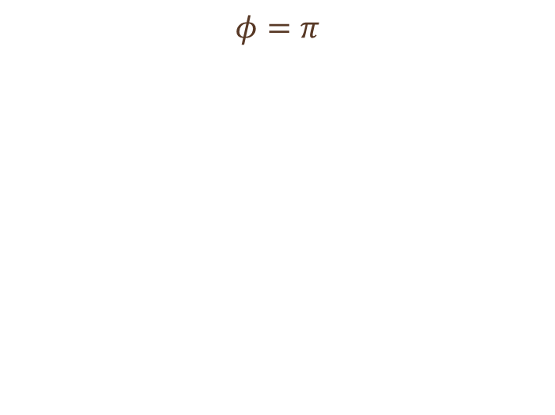
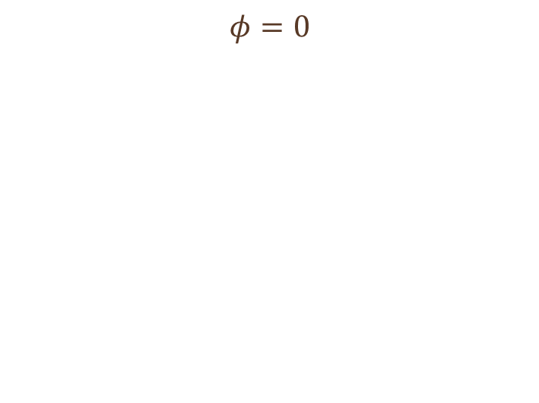
Effect of loss in the feedback loop
Quadrature variance in the lossy case:
$$𝒳_{out,θ^{′}}\left(ν_{s,Δ}\right)=\frac{1}{4}\frac{Lκ_{c}}{\left|ε_{Δ}\right|}$$
Wider range of fluctuations are allowed in time-delay, detuning, phase shift, etc.
$$φ=0$$
$$φ=π$$
^{[1]} N. N., S. Parkins, PRA, 94:023809 (2016)

Slide 19
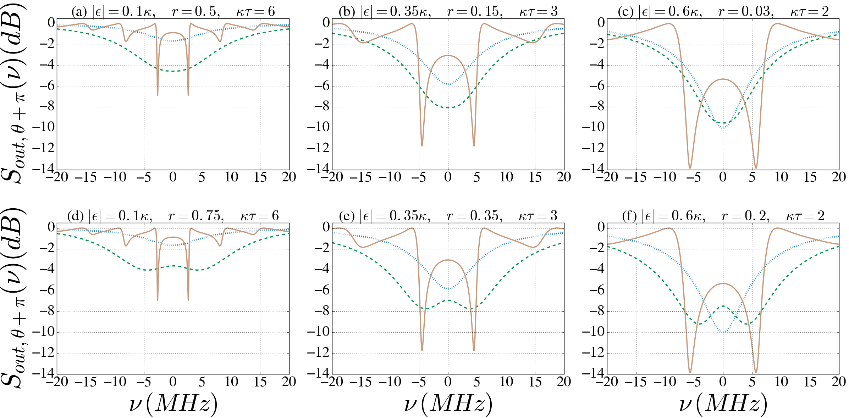
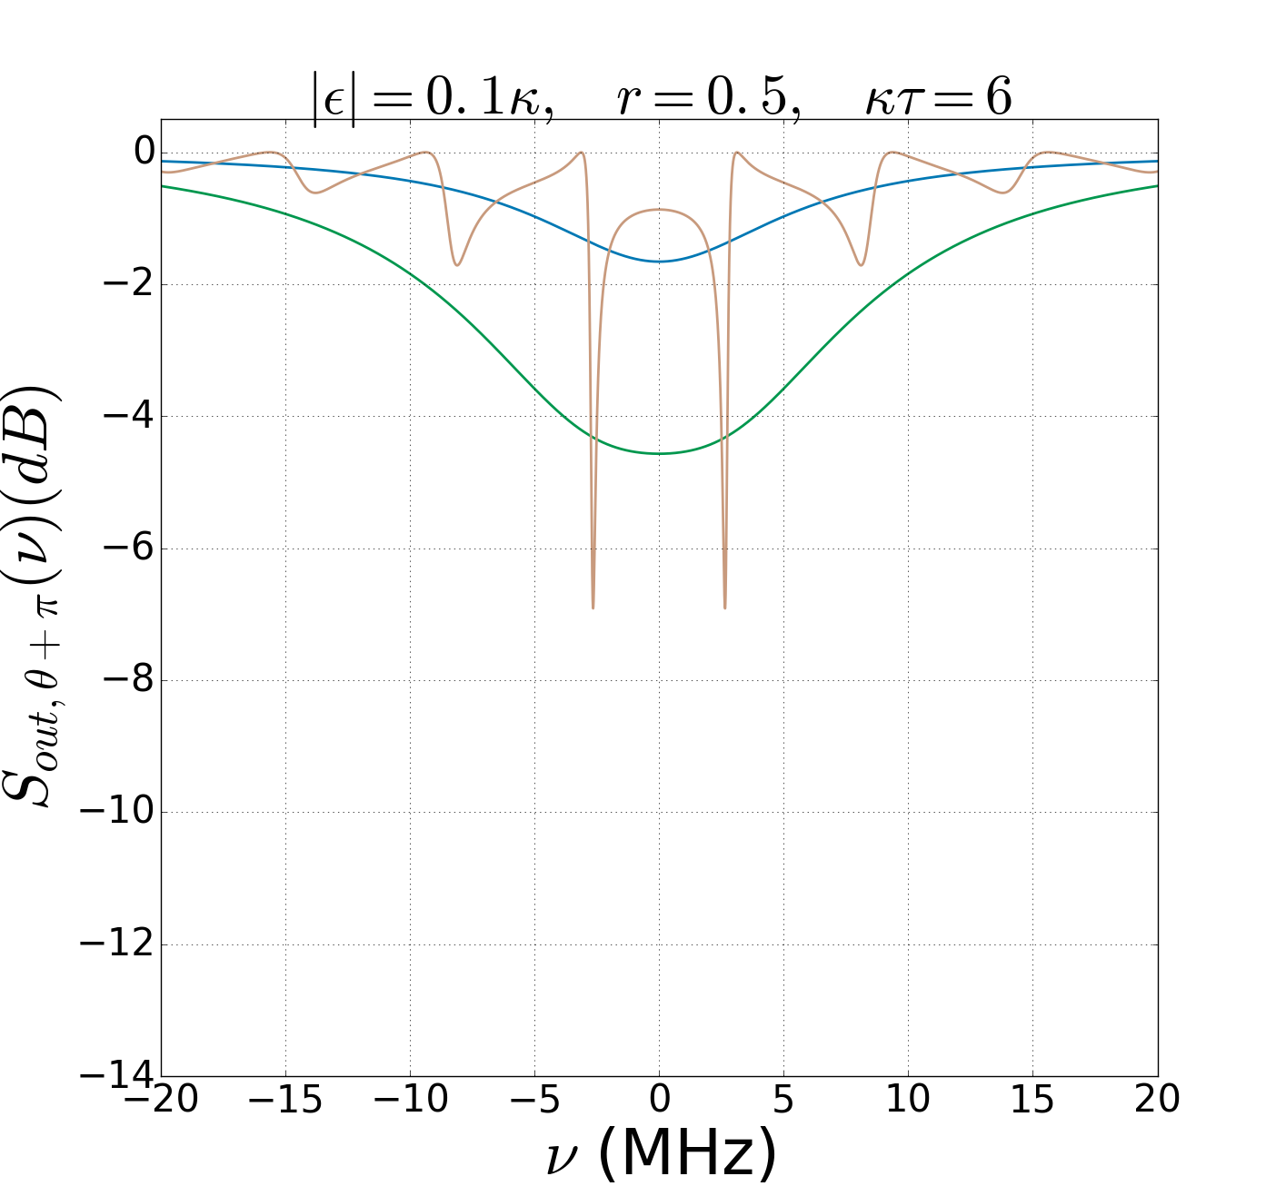
Comparison with previous results^{[1,2]}
with BS
feedback
without
feedback
with delayed feedback
without
feedback
with BS
feedback
without
feedback
with BS
feedback
with delayed feedback
with delayed feedback
^{[1]} J. E. Gough, S. Wildfeuer, PRA, 80:042107 (2009), ^{[2]}A. Furusawa’s group, IEEE Trans. Auto. Contr., 57:2045 (2012)

Slide 20
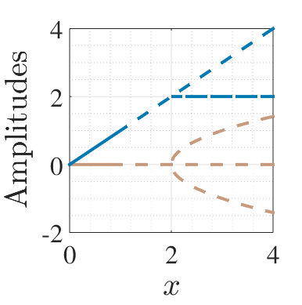
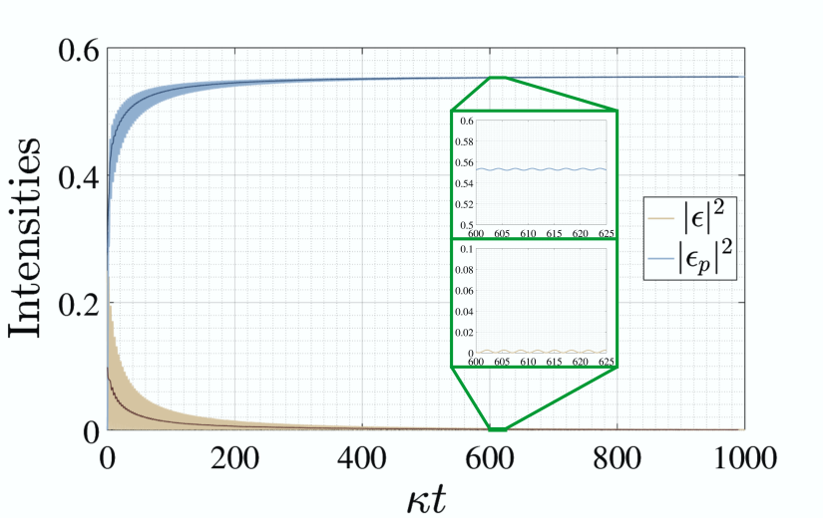
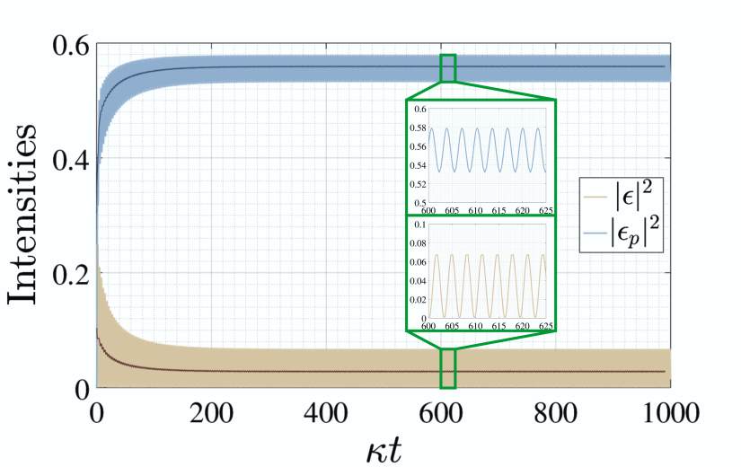
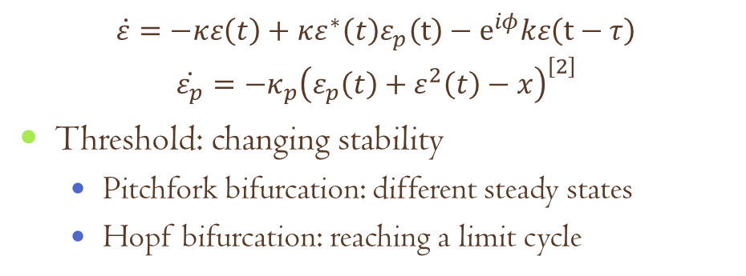
Classical analysis^{[1]}
$$\dot{ε}=−κε\left(t\right)+κε^{∗}\left(t\right)ε_{p}\left(t\right)−e^{iφ}kε\left(t−τ\right)$$
$$\dot{ε_{p}}=−κ_{p}{\left(ε_{p}\left(t\right)+ε^{2}\left(t\right)−x\right)}^{\left[2\right]}$$
Threshold: changing stability
Pitchfork bifurcation: different steady states
Hopf bifurcation: reaching a limit cycle
Imaginary eigenvalue becomes the frequency of persistent oscillations
^{[1]}Matlab package DDE-BIFTOOL, and solver dde23,^{[2]}H. Carmichael: Statistical Methods in Quantum Optics 2 (2009)

Slide 21
Summary
Coherent quantum feedback:
Backaction-free way of controlling a quantum systems
Influence of time-delay:
Memory effect in the environment
Changes in the stability landscape
Time-delayed one-loop setup with a DPA: dramatically enhanced squeezing
Enhancement even compared to previous feedback setups
Result of the changing dynamics of the system
Loss in the feedback loop decreases the degree of squeezing, but also provides higher tunability
Future plans:
General linear model for two different modes
Nonlinear systems

Slide 22
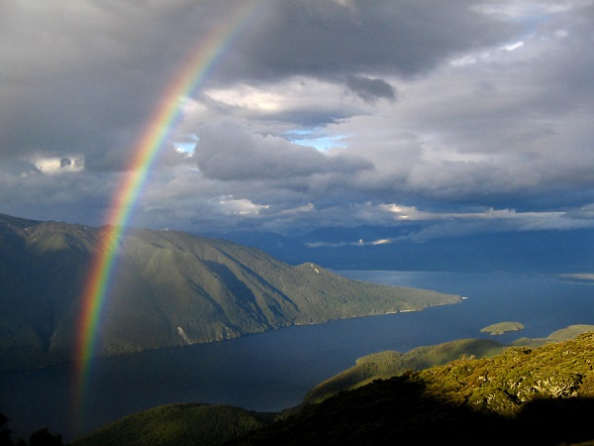

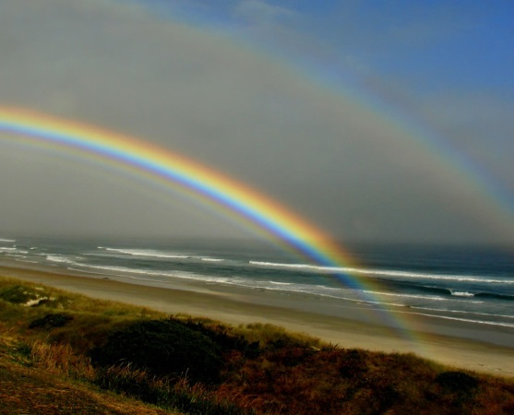

Thank you for your
1
2
3
4
5
6
7
8
9
10
11
12
13
14
15
16
17
18
attention!

Slide 23
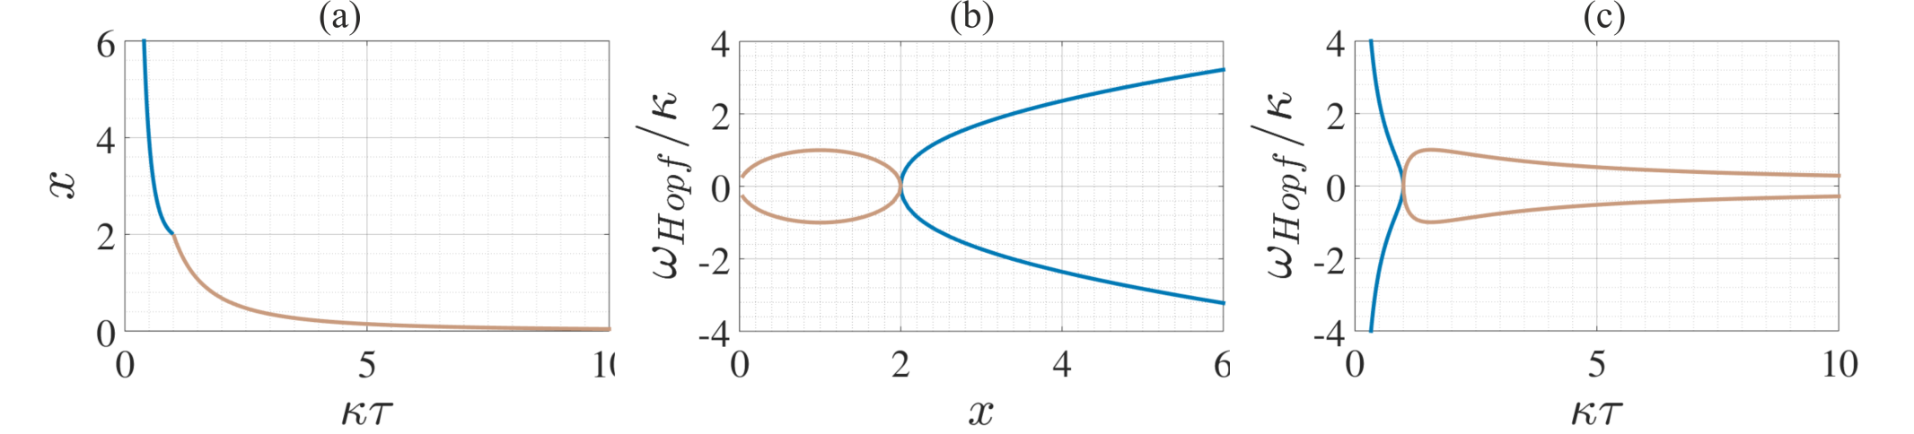
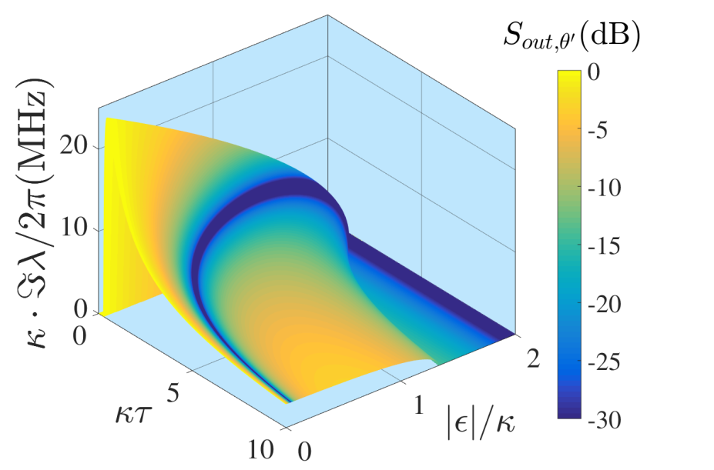
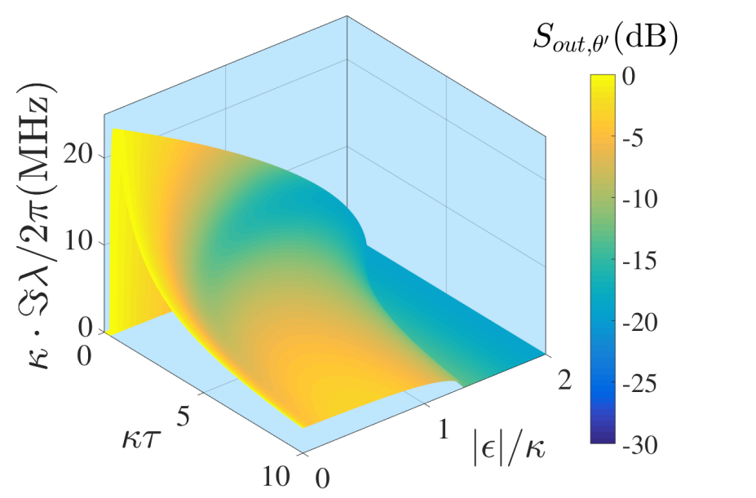
Tunability
$$0≤ν_{s}≤\sqrt{\left|ε\right|\left(2κ−\left|ε\right|\right)},0≤\left|ε\right|≤\left|κ+ke^{iφ}\right|$$

Slide 24
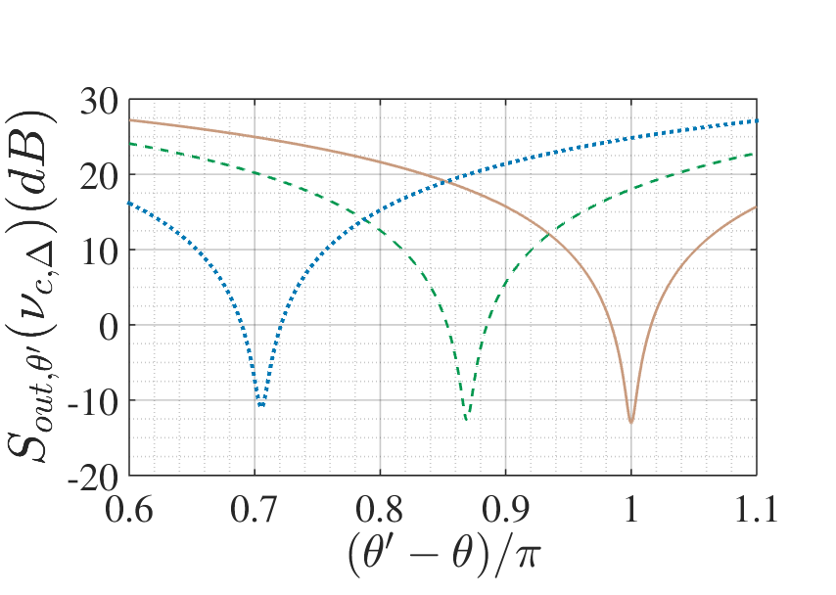





Effects of detuning
Characteristic quantities:
$$θ^{′}=θ−π+\arcsin\left(\frac{Δ}{{|ε}_{Δ}|}\right)$$
$$τ_{s,n,Δ}=\frac{\arccos\left(\frac{\left|ε_{Δ}\right|−κ}{k}\right)+2nπ}{ν_{s,Δ}}$$
$$ν_{s,Δ}=±\sqrt{k^{2}−{\left(\left|ε_{Δ}\right|−κ\right)}^{2}}$$
In the figures below:
$\left|ε\right|=const.$
$Δ=0$ (solid)
$Δ=0.1κ$ (dashed)
$Δ=0.2κ$ (dotted)
Optimal frequency and time-delay
$$φ=0$$
$$φ=π$$

Slide 25







Effects of a phase shift
In this figure:
$$k=κ, φ=\frac{π}{2}$$
$ε_{p}:$ real (blue), imag (green)
$ε:$ real (brown), imag (yellow)
In the figures below:
$\left|ε\right|=const.$
$φ=φ_{0}−0.1π$ (dotted)
$φ=φ_{0}−0.05π$ (dashed)
$φ=φ_{0}$ (solid)
Optimal frequency and time-delay
$$φ_{0}=0$$
$$φ_{0}=π$$

Slide 26



Frequency-dependent squeezing
Adding $π$ to the local oscillator phase in our case gives the following frequency-dependence of the optimal quadrature angle for the maximum squeezing:
Characteristic that is required for the new generation of gravitational wave detectors
Low frequencies: around $θ^{′}−θ=0$
High frequencies: around $θ^{′}−θ=π$

Slide 27


Degenerate Parametric Amplifier
Output below threshold: squeezed vacuum
Note: squeezed vacuum has finite number of photons in it
^{[1]}
$$\hat{H}=\frac{1}{2}iℏ\left(ε{\left({\hat{a}}^{†}\right)}^{2}+ε^{∗}{\left(\hat{a}\right)}^{2}\right)$$
^{[1]} Python package QUTIP

